Slide 1

บริษัทหริกุล ซายเอนซ์ จำกัด
เทคนิคการใช้งานปิเปตอย่างถูกต้อง
“Guide to Pipetting”
694 ซ.รัชดานิเวศน์ 24 ถ.ประชาราษฎร์บำเพ็ญ เขตห้วยขวาง กรุงเทพฯ 10321
Tel. 0-2274-2456 (automatic 9 lines) Fax. 0-2274-2443
Email. pipetman@harikul.com

Slide 2
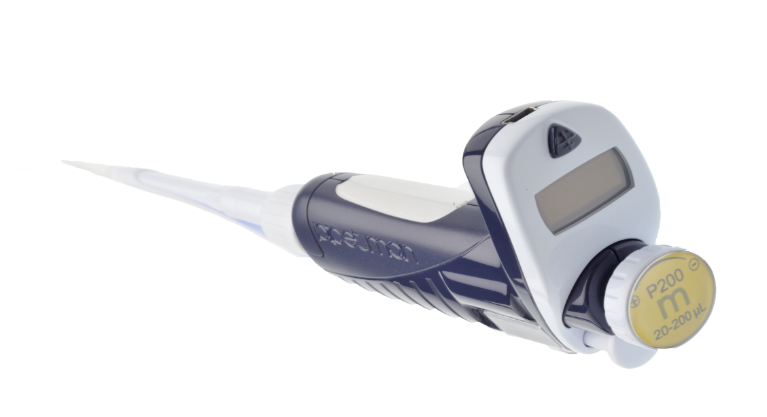
Choosing the right pipette
Air – displacement
Positive – displacement

Slide 3
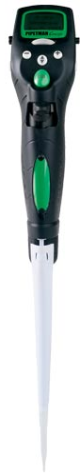
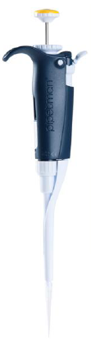
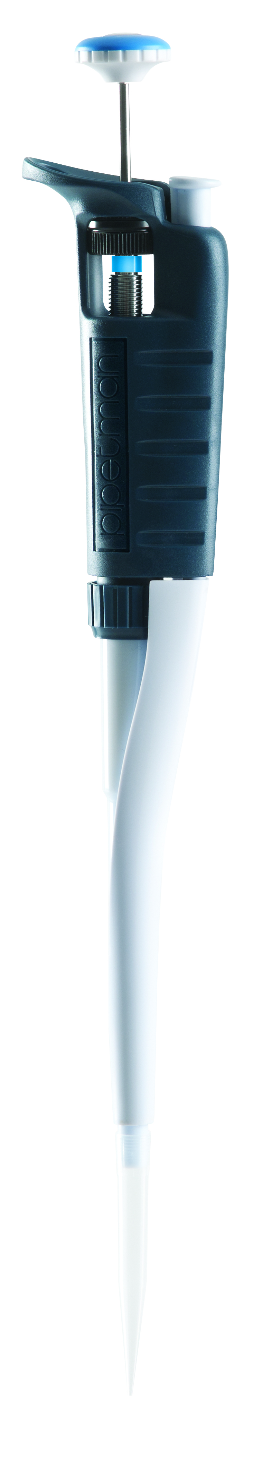
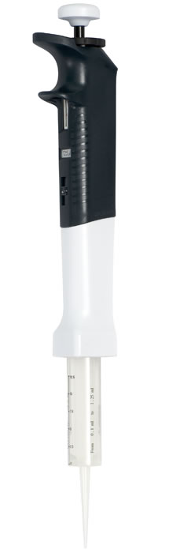
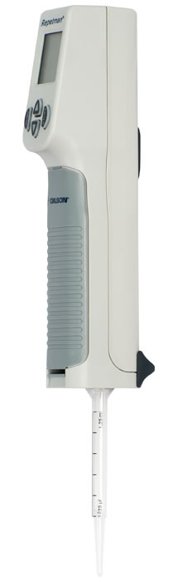
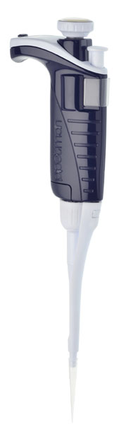
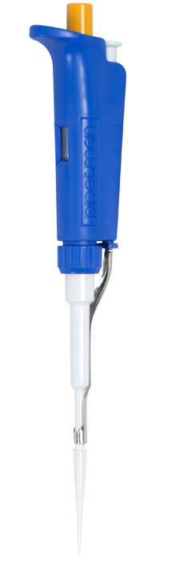
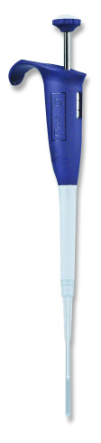
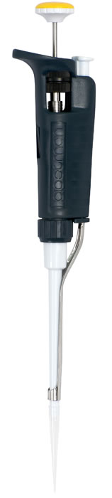
Two families for Gilson pipettes
Air-displacement
Positive-displacement

Slide 4
Operating principles
Air - displacement
Positive - displacement

Slide 5
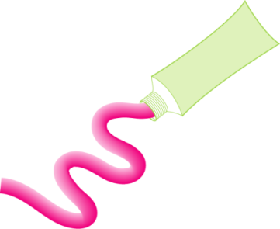
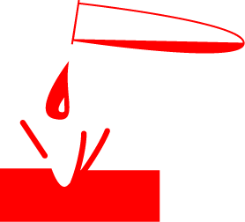



Select the best pipetting system/sample
Air-displacement
Positive-displacement
Notes:
FDA has recommended Microman to a Canadian pharmaceutical company (Novopharm) for pipetting solvents.

Slide 6
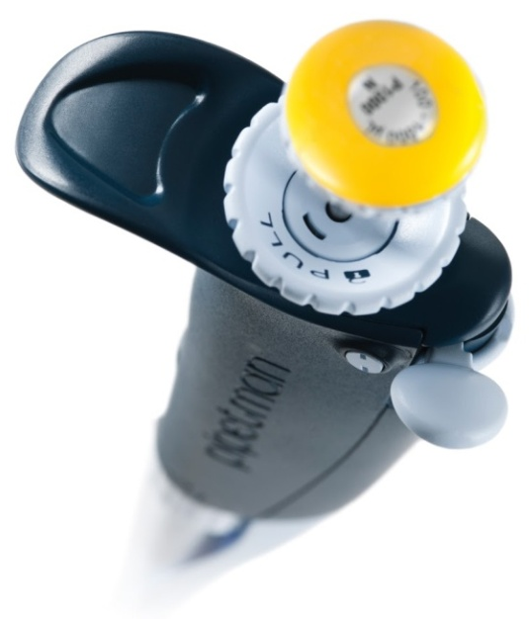
Air-displacement
Forward Mode
Reverse Mode

Slide 7
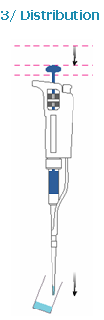

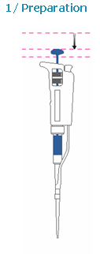
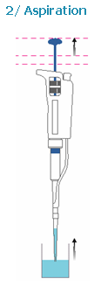
Air-displacement pipettes
forward pipetting mode
Rest position
First stop
Second stop or purge

Slide 8
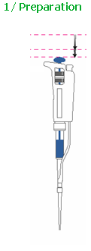
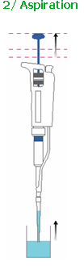
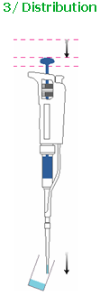
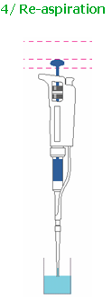
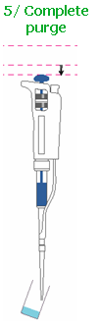
Air-displacement pipettes
reverse pipetting mode
Rest position
First stop
Second stop or purge

Slide 9
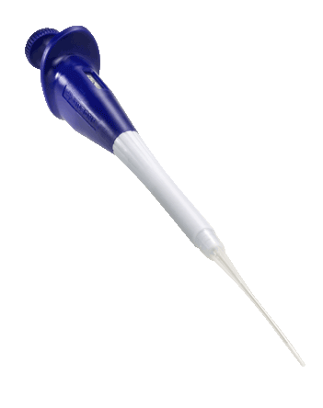
Positive-displacement
Capillary Pistons (CP)

Slide 10
Positive-displacement
1/ Preparation
2/ Aspiration
3/ Distribution
4/ Ejection
Rest position
First stop
Ejection

Slide 11
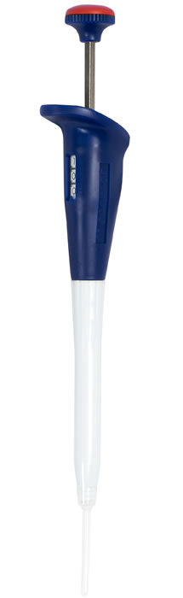


Slide 12
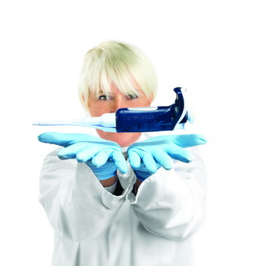
How to handle a pipette
Notes:
How to handle a pipette

Slide 13
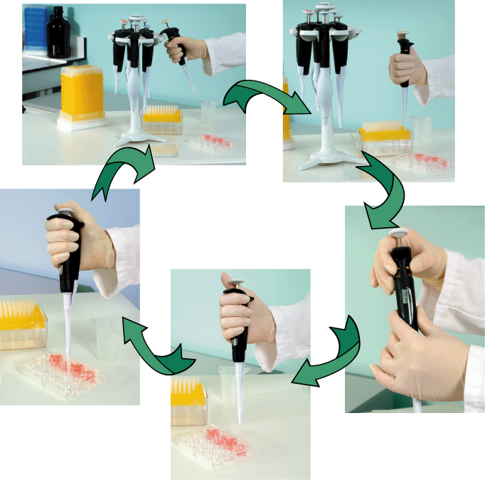
Pipetting cycle
1.Fit a tip
2.Set the volume
3.Pre-rinse
4.Aspirate
5.Dispense
6.Eject
7.Hold the pipette

Slide 14
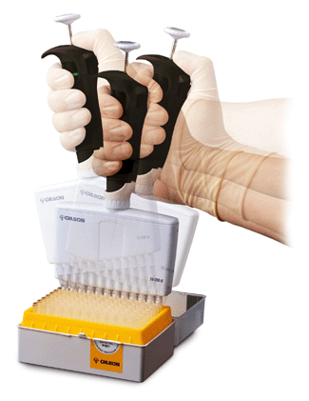
Fit a tip
Single channels
multichannels

Slide 15
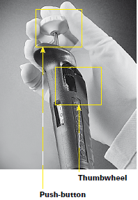
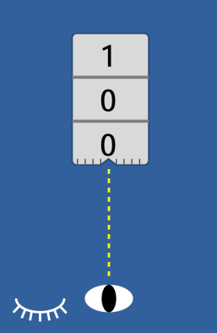
Set the volume
Set the volume
  - using the thumbwheel or the push-button
  For Pipetman Classic use the horizontal position
  and place your eye in front of the volumeter
Electronic display avoids parallax error

Slide 16
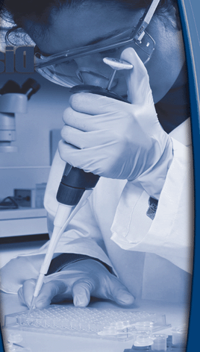
Pre-rinse
Aspirate with the tip and dispense back
Why?
  Wettability of the tip
  Greater uniformity
  Greater accuracy and precision
When?
  After changing the tip
  After increasing the volume

Slide 17
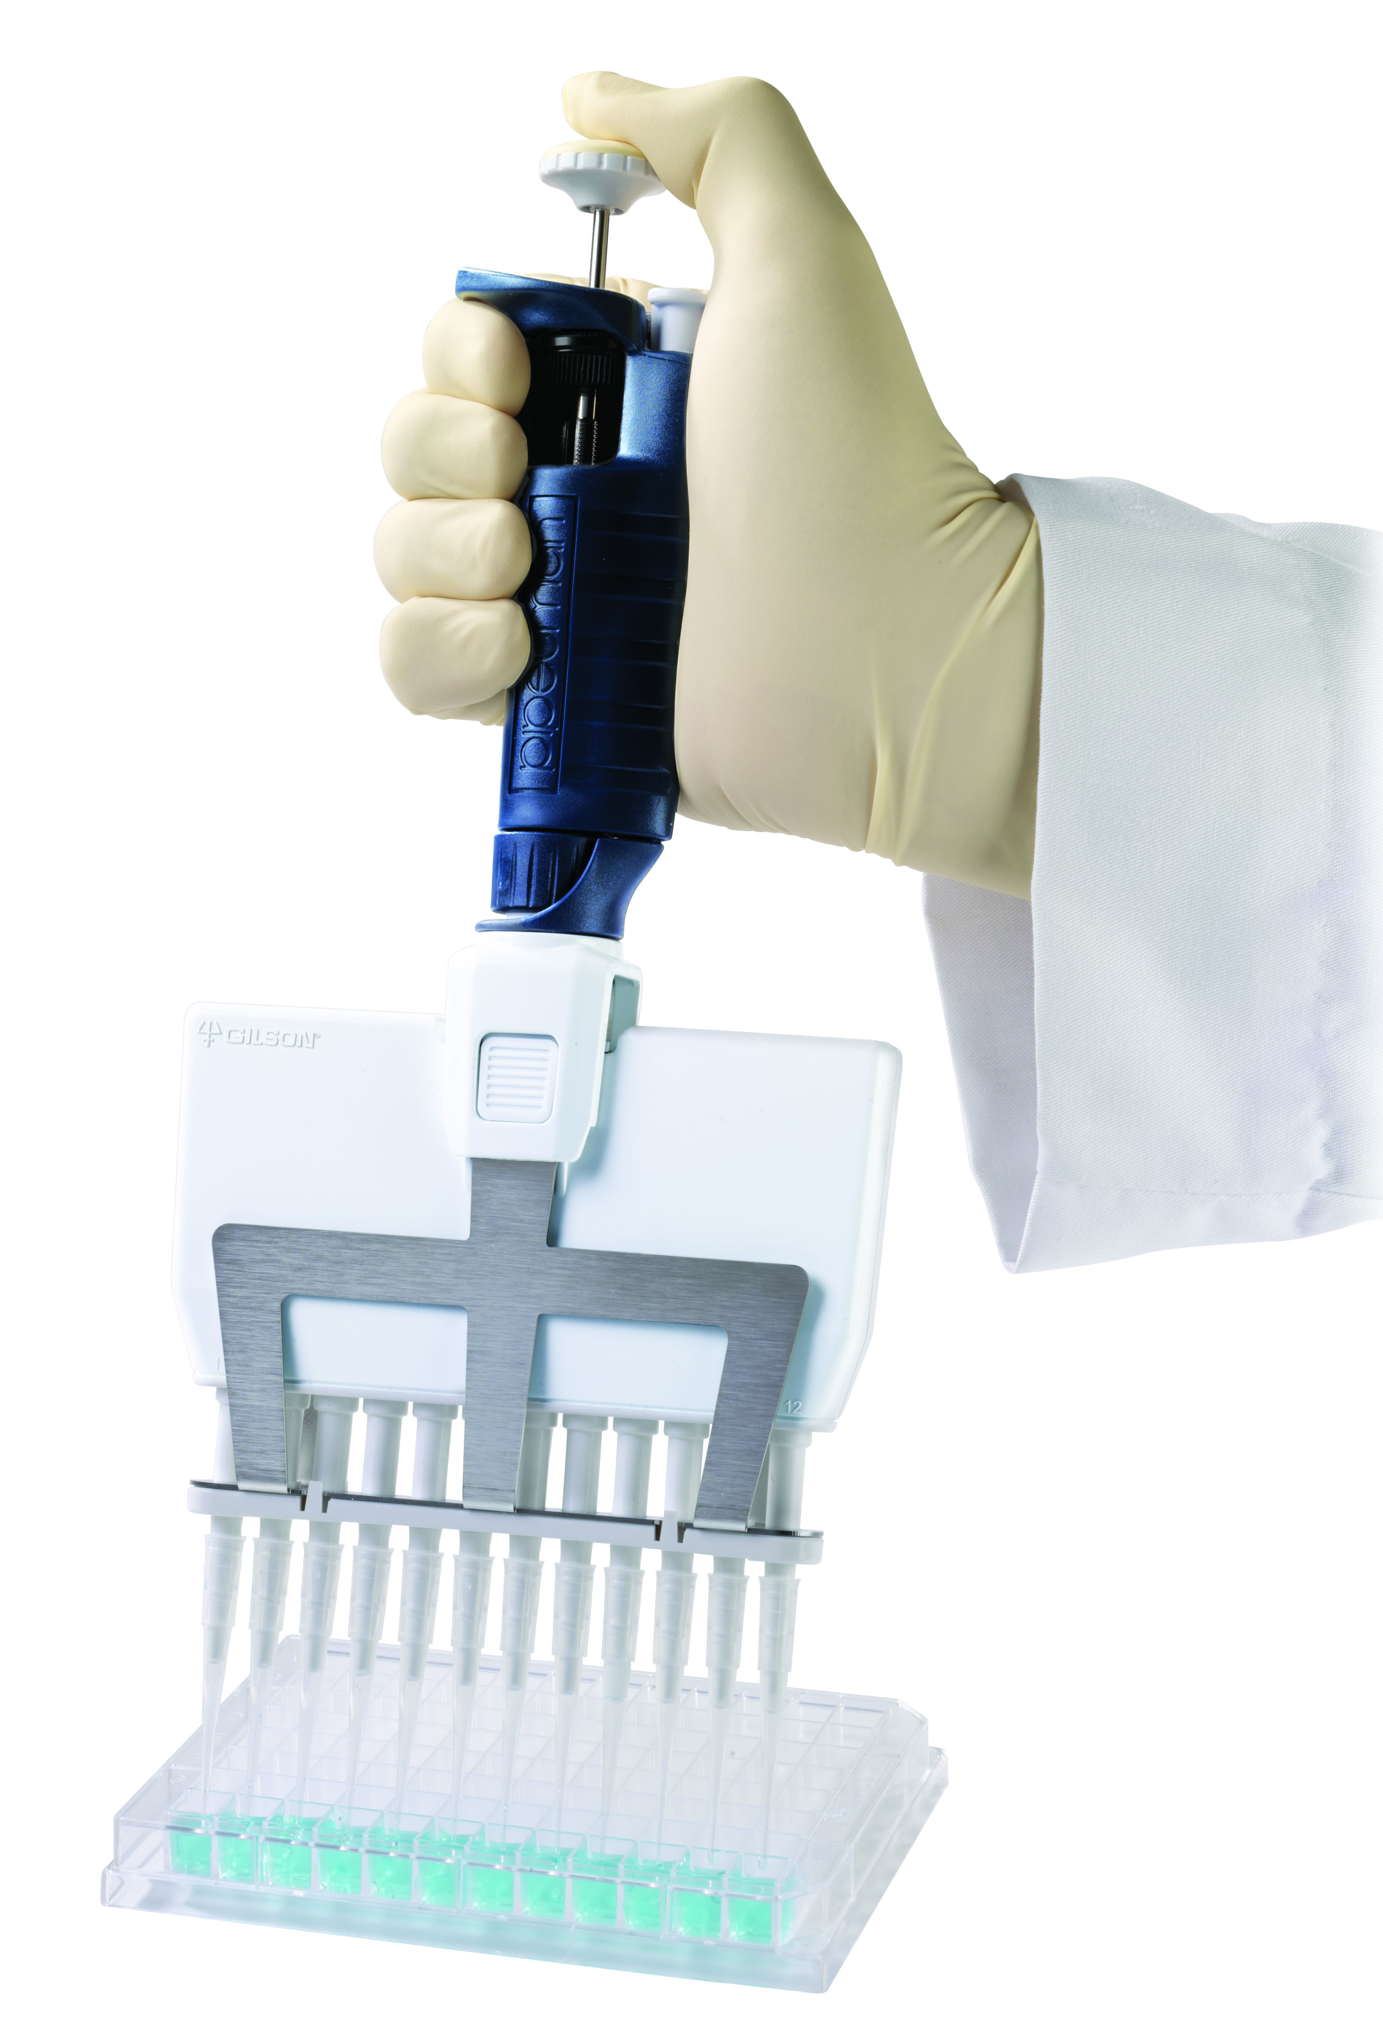
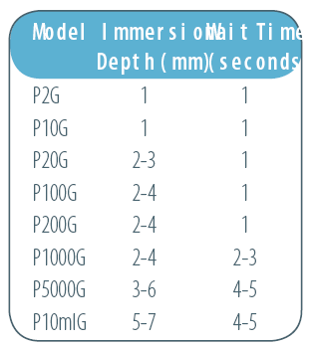
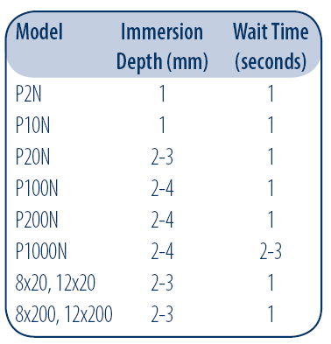
Aspirate

Slide 18
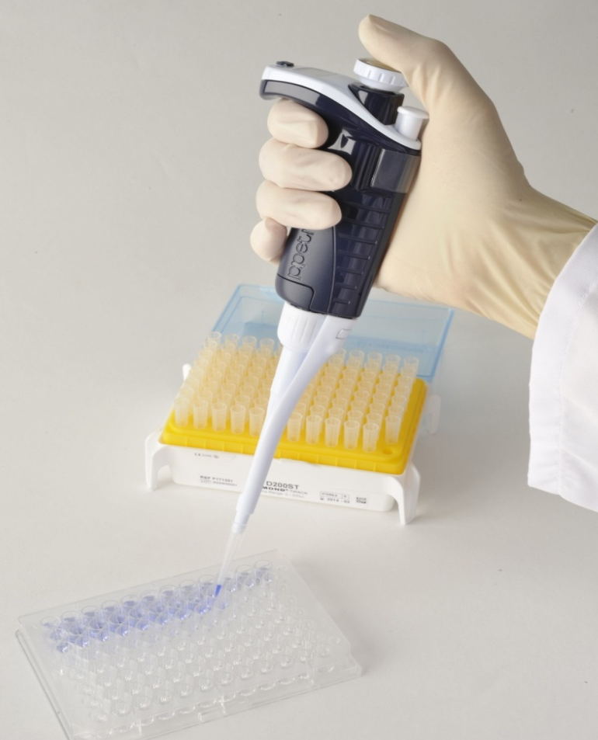
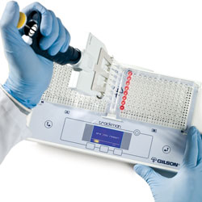
Dispense

Slide 19
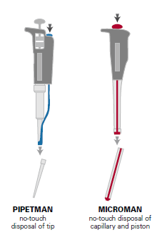
Eject

Slide 20
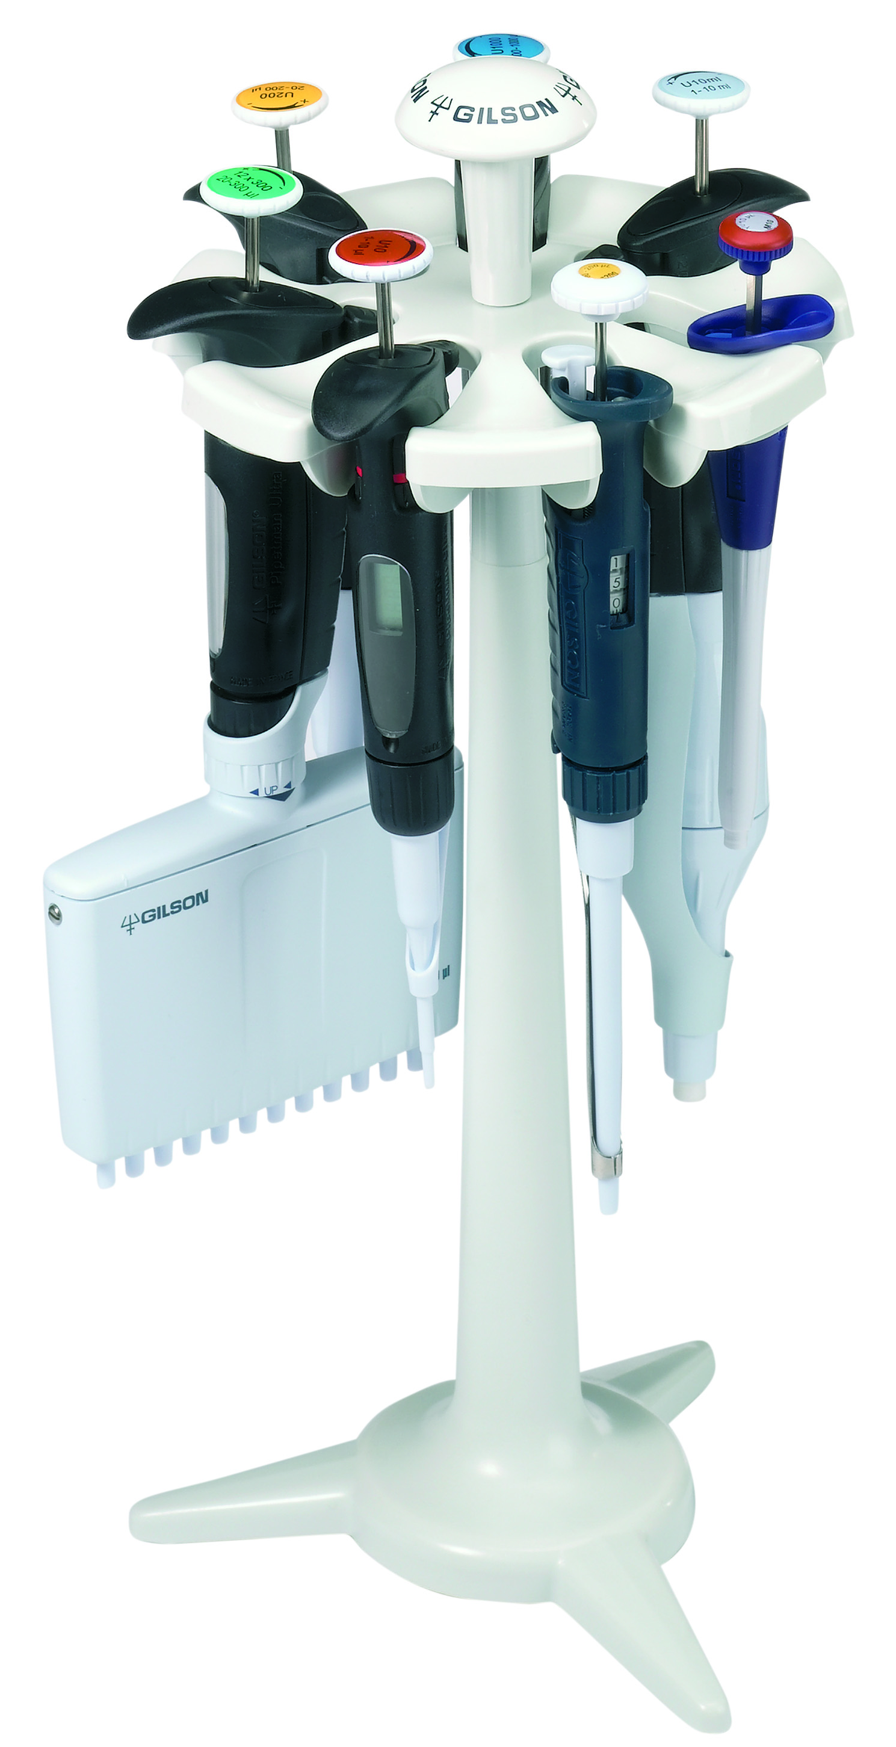
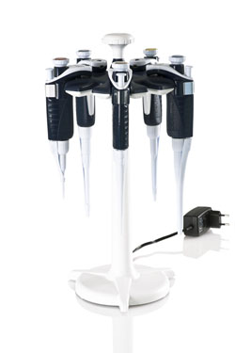
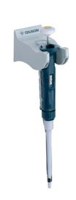
Hold the pipette

Slide 21
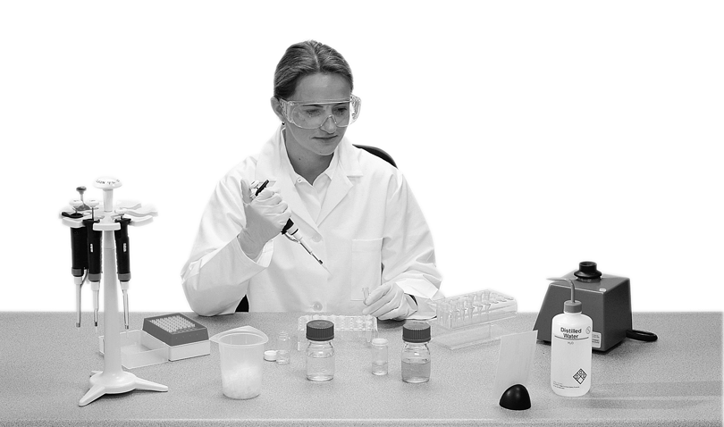
Improve your working day
Posture J
Chair or stool so that elbow on the bench
Hands below shoulder height
Reduce the height of applications such as
gel loading
Arms close to the body
Get organized J
Necessary objects within easy arm's reach
Pipettes within easy reach, on a stand
Most frequently used objects in front of you
Waste receptacles no higher than the end of your pipette

Slide 22
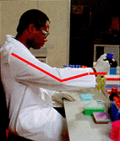
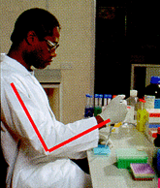
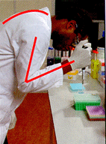
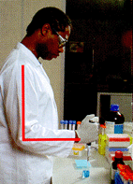
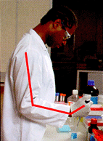
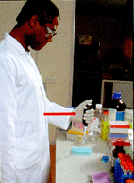
Posture
L Bad
Good J
Seated posture:
Lower back supported by chair
Upper back and neck upright
Upper arm vertical
Elbow bent at 90°
Wrist in the same plane as the forearm
Seated posture:
Shoulders elevated
Upper arm elevated
Elbow extended
Wrist in deviation
Standing posture:
Upper back and neck stopped
Lower back and trunk stopped
Elbow flexed
Standing posture:
Lower back and trunk upright
Upper back and neck upright
Upper arm vertical
Elbow bent at 90°
Forearm parallel to the floor
Wrist in the same plane as the forearm
Wrist posture:
Upper arm flexed
Elbow extended
Wrist deviated downward
Wrist posture:
Forearm parallel to the floor
Wrist and forearm in the same plane

Slide 23
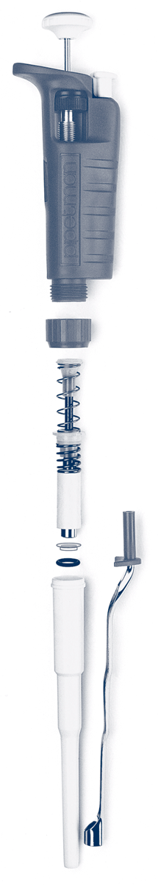
Regular maintenance

Slide 24
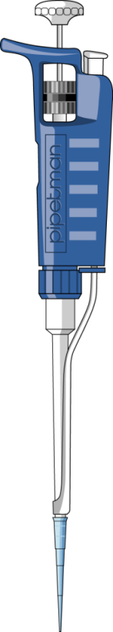


Leak test
From 0.2 µL up to 200 µL
From 1000 µL to 10 mL
Step 1
Step 2
Step 1

Slide 25
Cleaning
External
  Remove the tip ejector
  Wipe with soap solution
  Wipe with distilled water
Connecting nut
Internal
  Disassemble the lower part
  Clean then rinse the tip holder,
  piston assembly and seals
  Leave to air dry and reassemble
Piston assembly
Seal & O-ring
Tip ejector
Notes:
When?
- Use of …: P5000 and P10ml filters!
Piston: no grease, no lubrication. Dry seal technology.
With grease: greased pistons must be regreased regularly or leaks lay occur. The grease may be altered by vapors from liquids pipetted
Grease can also introduce contaminating particules into the body of the pipette.
Why? For application purpose

Slide 26
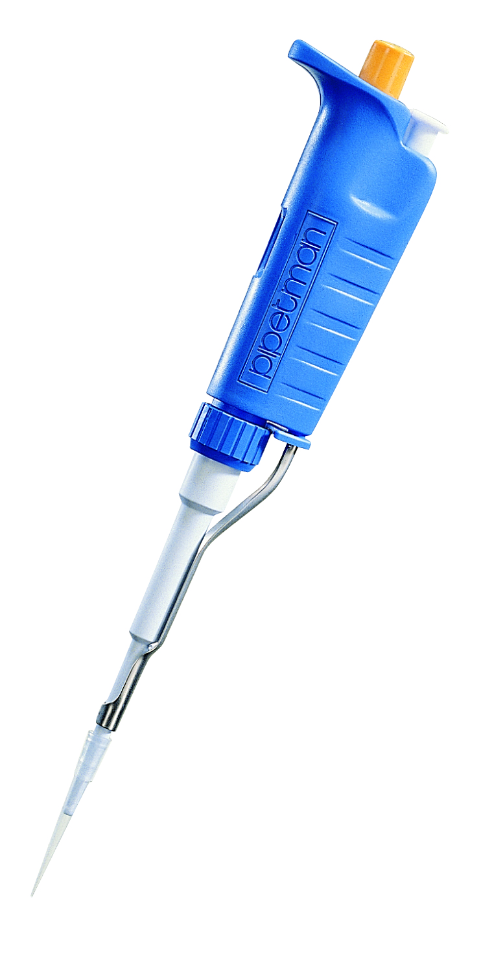
Disassemble &
Reassemble

Slide 27
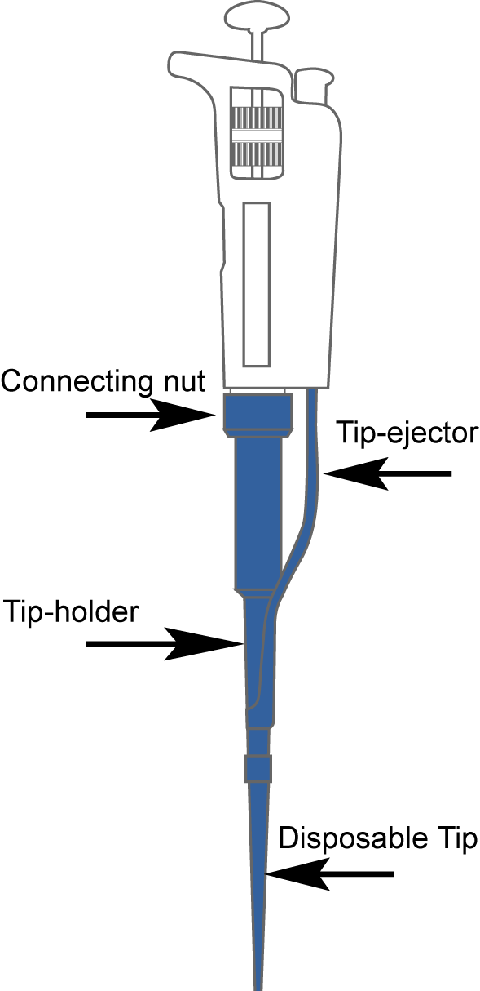
Autoclaving
lower part is autoclavable
connecting nut; tip ejector; shaft/tip holder Moist heat/121°C/20 minutes/1 bar

Slide 28
Maintenance frequency

Slide 29
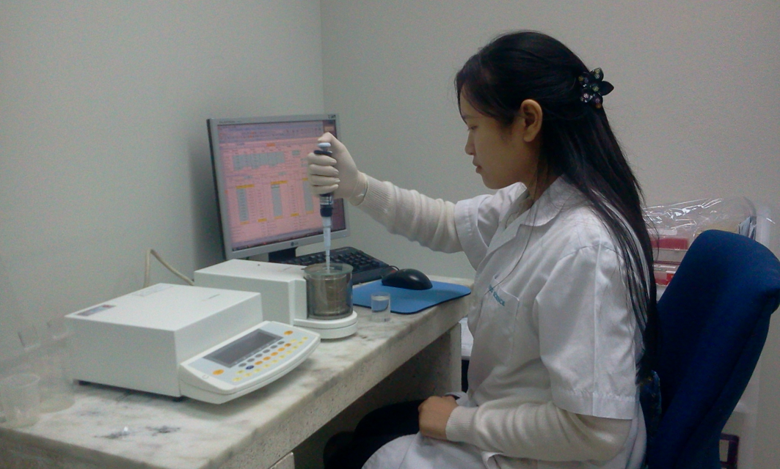
Performances check

Slide 30

Specifications
Notes:
At this stage: pipette in good working condition
Definition of accuracy: Closeness of agreement between the nominal volume and the mean volume
and precision: Closeness of agreement between individual volumes (repeatability)

Slide 31



Performances
Precise
but not accurate
Accurate
but not precise
Accurate and precise
Systematic error
Random error

Slide 32
Errors
Systematic error
  Z factor not adequate
  Needs adjustment
Random error
  Tips
  Technique
  Piston

Slide 33
Parameters
CONSISTENCY
OPERATING MODE
Stabilization
IMMERSION DEPTH
Regularity
QUALIFICATION
SPEED
EVAPORATION
Weighing vessel
PRE RINSING
Vibrations
LID
AIR CONDITIONNING
Shape
TECHNIQUE
RECORDER
SIZE
AIR TEMPERATURE
WATER TEMPERATURE
CONTROLS
MARBLE TABLE
STABILITY
BALANCE
ENVIRONMENT
EQUIPMENT
DRAUGHTS
SPECIFICATIONS
DIRECT SUN
READIBILITY
LINEARITY
DENSITY
Repeatability
HUMIDITY
Air buoyancy
TIPS
MAINTENANCE
Drift
WATER
PERIODICAL CHECKS
AIR PRESSURE
Perfectly formed
TRACEABILITY
STANDARD MASS
CLASS
Smooth and regular
AIR-TIGHT FIT
Clean
WETTABILITY
Fine point finish

Slide 34
Sources of error

Slide 35






Pipette Tips
Non Gilson Tips
L
Gilson Diamond Tips
Sealing ring for airtight fit
Identification:
mold and cavity
Rough surface
Excess plastic
Translucent,
no dyes
Level marks
Fully autoclavable, even the filter
Rough surface
Imperfect point aperture
Fine point
and flexibility
JPerfect point

Slide 36

calibration method

Slide 37

Harikul Calibration Laboratory
Gravimetry method
Test Volume: minimum and Maximum
Test Volume: minimum Medium and Maximum

Slide 38
Equipment : Balances requirement
Volume (ul) | HARIKUL | ISO 8655
0.1 ul.≤V <1 ul. | 0.0001 mg | -
1 ul ≤V≤10 ul | 0.0001 mg | 0.001 mg.
10 ul <V≤20 ul | 0.0001 mg | 0.01 mg.
20 ul <V≤ 100 ul | 0.001 mg | 0.01 mg.
100 ul <V≤ 1000 ul | 0.01 mg. | 0.1 mg.
1 ml <V≤ 10 ml | 0.01 mg. | 0.1 mg.
10 ml <V≤ 200 ml | 0.01 mg. | 1 mg.
Notes:
One 6 digit balance and another one that works on two scales.
Balances should be calibrated, maintained, and recognized by the international department of weighing and measurements.
To minimize vibration, balance on a marble table or equivalent. Balance area free of draughts and the ambient area free of dust.

Slide 39
Environmental factors to be respected
23
20
22.5 ±7.5°C
20.0 + 2°C
Above 50%
40% to 60%
101kPa
101kPa
ISO 8655
Harikul Calibration Laboratory
Do not forget: Conversion factor
Evaporation loss

Slide 41

Questions / Comments
Costumer Service

